Slide 1
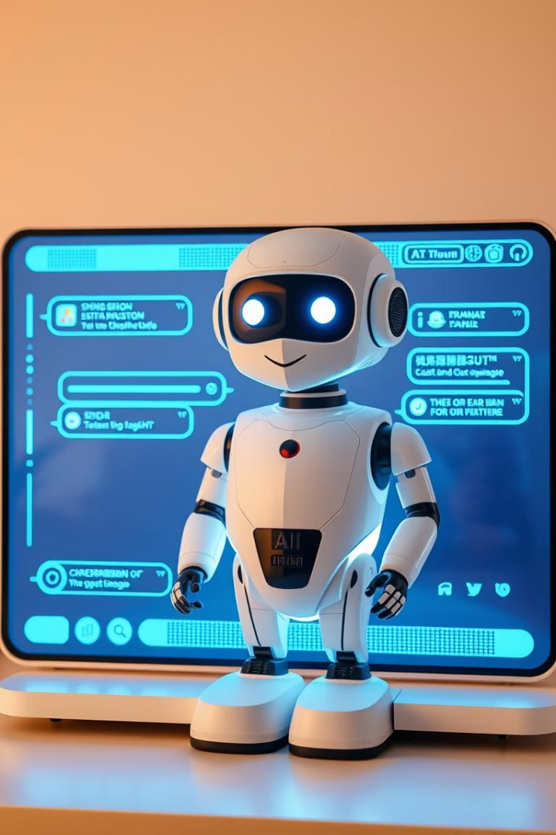
The CloudXperte AI Assistant offering
check out www.VehicleTracking.ai, our AI assistant solution gives quick, accurate answers to customers while showing you helpful data about your operations. It works with your current systems, cuts response times by up to 80%, and helps you make better decisions to improve fleet efficiency and grow your business.

Slide 2
About CloudXperte
Expertise
Innovation
We've completed over 350 projects worldwide. Top companies trust us as their tech advisors across many industries.
We build custom solutions that work well and solve tough business problems for our clients.
Global Reach
Our AI tools help clients around the world, meeting local needs while keeping high standards everywhere.

Slide 3
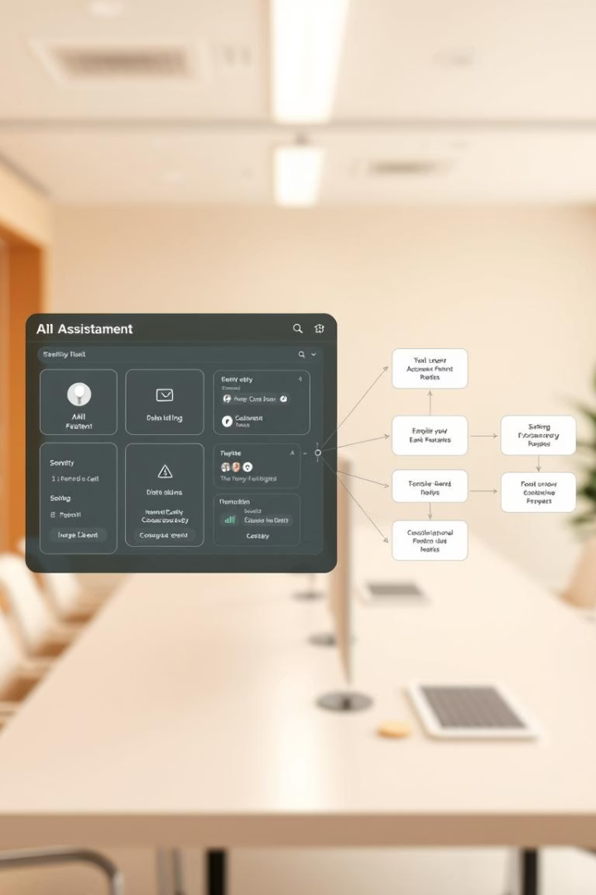
How cloudXperte Revolutionizing Product Knowledge
Built for software product teams to solve documentation problems and work more efficiently.
Our AI Assistant fills knowledge gaps by giving you quick, accurate information about product features and design.
It understands how different parts of your software connect and work together, providing clear explanations that are both accurate and relevant.
It also helps analyze data, turning complex information into useful insights by automatically processing real-time statistics.

Slide 4
Making Customer Connections Better
Always Available Help
Smart Message Understanding
Better Sales Conversations
Get help anytime, day or night. No waiting for answers, with support ready in every time zone.
Our AI reads questions clearly, finds the right area of the product, and gives answers that fit your needs.
Helps sales teams by letting potential customers explore what our product can do and get information about what matters to them.

Slide 5
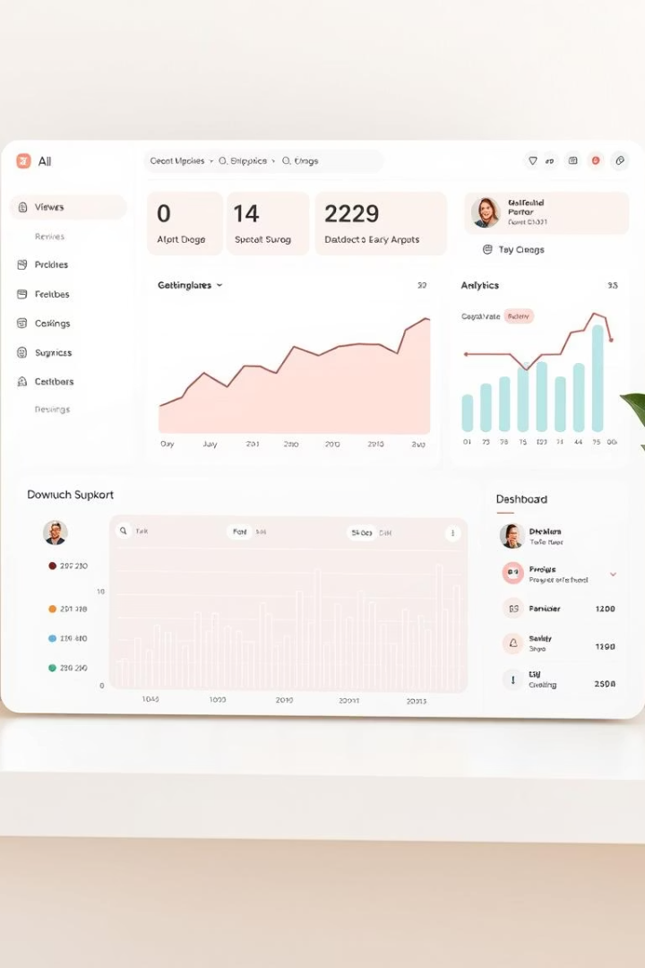
Key Features & Benefits
24/7 Availability
Always ready to help customers at any time. No waiting needed, which makes users around the world happy.
Personalized Interactions
Creates better connections by using customer history to offer relevant help. This builds stronger relationships with users.
Cost-Effective
Saves up to 30% on costs by handling simple questions automatically. This lets your team focus on solving complex issues.

Slide 6
Data Accuracy & Ease of Use
Continuous Learning
Intuitive Interface
Our AI assistant gets better with each conversation. It studies how people ask questions to improve its answers, helping it adapt to what users need and how they speak. We use feedback to make key improvements, cutting down on mistakes while keeping information up to date.
Our platform is simple and easy to use, letting anyone manage content without needing technical skills. The clean design makes it accessible to everyone with no training needed.
Features like drag-and-drop, simple navigation, and clear visual organization make it quick to learn and implement.
The system checks facts in real time to prevent wrong information, and we test thoroughly to make sure it works well across all customer support channels.
Clear guides help users manage content on their own. It works smoothly with your existing systems to keep your business running efficiently.

Slide 7
Industry Applications
Retail
Healthcare
Financial Services
Education & Enterprise
Uses AI to suggest products and track orders in real time. This boosts customer happiness by 40% and increases sales through better engagement.
Makes patient care better with smart scheduling, round-the-clock support, and secure messaging. Cuts paperwork by 30% while improving care.
Gives quick answers to money questions, explains complex terms simply, and uses extra security checks. This builds trust and keeps clients longer.
Makes knowledge easier to find with simple access to resources, automated help, and 24/7 tools. Boosts output while lowering costs.
Travel & Logistics
Uses GPS tracking, predicts delays with AI, and finds the best routes. Cuts fuel costs by 15% and helps deliveries arrive on time.

Slide 8
Commitment to Innovation
At CloudXperte, we always work to improve VehicleTracking.ai with new features that make things better for customers in many fields.
Our AI experts are leaders in building new service tools. We make solutions that work now and are ready for the future—helping both our company and clients stay ahead.

Slide 9
Contact Us
15, Software Technology Park of India, Chikalthana MIDC Area, Aurangabad, Maharashtra 431210.
+918113861000
info@cloudxperte.com
https://cloudxperte.com/

